Slide 1

Reinforcement Learning
Presentation Materials

Slide 2
Agenda
No. | Topic | Page
1 | Definition / Goal of Reinforcement Learning | 3
2 | K-armed Bandits, Exploration-Exploitation tradeoff | 7
3 | Markov Decision Processes | 10
4 | Value functions, Policies, Bellman Equations | 13
5 | Policy evaluation, Policy control, Policy iteration | 22
6 | Monte Carlo Methods | 31
7 | Temporal Difference Learning, Sarsa, Q-learning | 48
6 | OpenAI gym | 57
7 | Roadmap | 58
8 | References | 59

Slide 3
What is Reinforcement Learning?
Unsupervised Learning
Dataset with no labels. No specific outcome/answer. Find/analyse structure in the data
Supervised Learning
Dataset with labels. Specific outcome/answer. Predict test data to the correct outcome.
Reinforcement Learning
No dataset nor labels. An environment with rules, rewards/penalties. Computer finds a sequence of decisions to maximize (long-term) reward, with repeated trials.
Notes:
Unsupervised Learning
a dataset without explicit instructions on what to do with it. The training dataset is a collection of examples without a specific desired outcome or correct answer. Unsupervised learning method then attempts to automatically find structure in the data by extracting useful features and analyzing its structure.
Supervised Learning
Every datapoint is tagged with the answer the algorithm should come up with
Fully labeled means that each example in the training dataset is tagged with the answer the algorithm should come up with on its own. So, a labeled dataset of flower images would tell the model which photos were of roses, daisies and daffodils. When shown a new image, the model compares it to the training examples to predict the correct label.
Reinforcement Learning
To get the machine to do what the programmer wants, the artificial intelligence gets either rewards or penalties for the actions it performs. Its goal is to maximize the total reward. Although the designer sets the reward policy–that is, the rules of the game–he gives the model no hints or suggestions for how to solve the game. It’s up to the model to figure out how to perform the task to maximize the reward, starting from totally random trials and finishing with sophisticated tactics and superhuman skills.

Slide 4
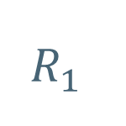
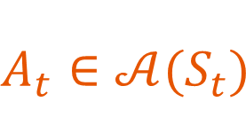
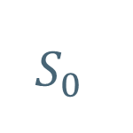
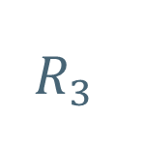
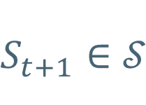



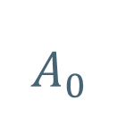
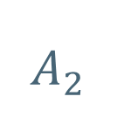

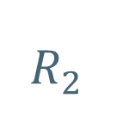
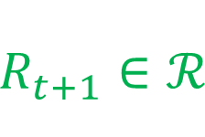
Fundamental concepts in Reinforcement Learning
Reward
$R_{t+1}∈ℛ$
Agent
Policy
State
$S_{t+1}∈𝒮$
Action
$$A_{t}∈𝒜(S_{t})$$
Environment
$$A_{0}$$
$$R_{1}$$
$$A_{1}$$
$$R_{2}$$
$$A_{2}$$
$$R_{3}$$
$$S_{0}$$
$$S_{1}$$
$$S_{2}$$
$$S_{4}$$
…….
Notes:
Agent: Agent in RL is the component that makes the decision of what action to take. Such as a cleaning robot which is suppose to pick up trash. There can be multiple agents interacting simultaneously or one after another.
Environment: The "environment" is typically a set of all possible states the "agent“ can move around in. Environment contains a set of rules (often stochastic) that governs the agent, rewards, penalties.
Policy: Policy is a distribution over actions for each state. A policy maps each state to actions. There are many types of policies: deterministic policies, which map a state to a single action, stochastic policies, which map a state to a distribution of actions. One of the assumption is that policies depend only on the current state, not on other things like time or previous states. This is because we model this framework with Markov Decision processes, which has the assumption that the state includes all the information required for decision-making.
Action: is something that the agent executes which leads to a reward/penalty, and to a new/old state in the environment
State: The state describes the current situation
Reward: reward is something that the agent is trying to maximize. Because the environment is modelled after Markov decision processes, each action produces an immediate reward. But it also brings the agent to another state with a potentially different set of possible future rewards. This leads to the exploration-exploitation dilemma. To maximize the long-term reward, should the agent choose the best immediate reward, or should it explore new states with poorer immediate rewards but potentially better rewards in the future time steps? We will talk about this exploration-exploitation dilemma in the next few slides.
So the whole process follows like this:
A reinforcement learning agent interacts with its environment in discrete time steps, t = 1,2,3,4,5… this can be finite or infinite time steps.
At each time step t, the agent receives an observation: the set of all available actions. The agent chooses an action based on its policy. And this action is sent to the environment. The environment moves into a new state at time step t+1, leading to a new state and also creating a reward (penalty). This whole cycle repeats again and stops if there is a finite time step or if the goal of the RL is achieved. I.e. the game of chess has ended.

Slide 5
Goals and Steps in Reinforcement Learning
Goal: Maximize the total reward by learning a sequence of actions
Steps:
Formulate the problem into Markov Decision Process
Set up a policy
Specify polices, value-functions, action values, deriving Bellman equations
Improving policy to become the optimal policy
Understand properties of optimal policies
Policy evaluation, policy control, policy iteration, policy improvement algorithms

Slide 6
Markov Decision Process (K Armed Bandits example)

Slide 7






Consider simple setting in RL: K-Armed Bandit Problem
Agent
K = 3
Actions
States
Reward
(Patient’s Health)
Exploitation-exploration trade-off
Notes:
Imagine a medical trial where a doctor wants to measure the effect of three different treatments. Whenever patient comes into the office, the doctor prescribes a treatment at random. The doctor then monitors the patient and observes any changes to their health. After a while, the doctor notices that one treatment seems to be working better than the others. The doctor must now decide between sticking with the best-performing treatment or continuing with the randomized study.
If the doctor only prescribes one treatment, then they can no longer collect data on the other two. Perhaps one of the other treatments is actually better, it only appears worse due to chance. If the other two treatments are worse, then continuing the study risk the health of the other patients.
This medical trial exemplifies decision-making under uncertainty. Should the doctor focus on exploration by testing out the different medications, or focus on exploitation by using the treatment that gives us the best immediate result? This highlights the exploration-exploitation delimma
The medical trial example is a case of the k-armed bandit problem. In the k-armed bandit problem, we have a decision-maker or agent, who chooses between k different actions, and receives a reward based on the action he chooses.

Slide 8
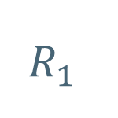
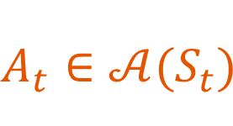
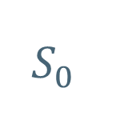

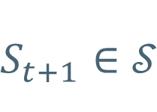




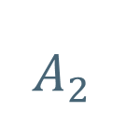

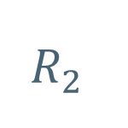

Markov Decision Process (MDP)
Reward
$R_{t+1}∈ℛ$
Agent
Policy
State
$S_{t+1}∈𝒮$
Action
$$A_{t}∈𝒜(S_{t})$$
Environment
$$A_{0}$$
$$R_{1}$$
$$A_{1}$$
$$R_{2}$$
$$A_{2}$$
$$R_{3}$$
$$S_{0}$$
$$S_{1}$$
$$S_{2}$$
$$S_{4}$$
…….
Notes:
Markov decision processes
MDP is defined as the collection of the following:
States: S
Actions: A(s), A
Transition model: T(s,a,s’) ~ P(s’|s,a)
Rewards: R(s), R(s,a), R(s,a,s’)
Policy:

Slide 9





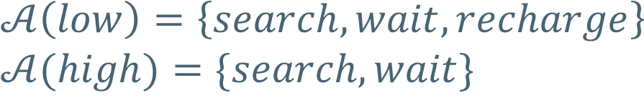
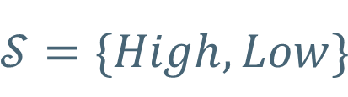
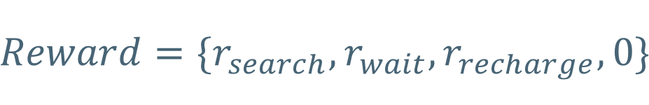
Markov Decision Process (MDP): Robot Cleaning example
$$𝒮=\{High,Low\}$$
$$𝒜\left(low\right)=\left\{search, wait, recharge\right\}$$
$$𝒜(high)=\{search, wait\}$$
$$Reward=\{r_{search},r_{wait},r_{recharge}, 0\}$$

Slide 10
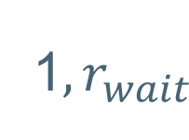
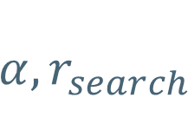
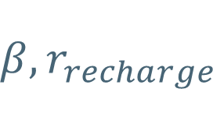
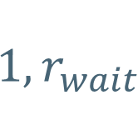
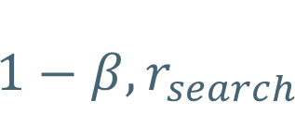
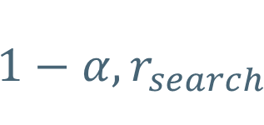
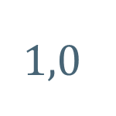
Markov Decision Process (MDP): Robot Cleaning example
$$1, r_{wait}$$
Wait
Wait
1${,r}_{wait}$
High
Recharge
Low
$$1,0$$
Search
Search
$$1−α, r_{search}$$
$$1−β, r_{search}$$
$$α, r_{search}$$
$$β, r_{recharge}$$
Notes:
Markov decision processes are an extension of Markov chains; the difference is the addition of actions (allowing choice) and rewards (giving motivation). Conversely, if only one action exists for each state (e.g. "wait") and all rewards are the same (e.g. "zero"), a Markov decision process reduces to a Markov chain.

Slide 11
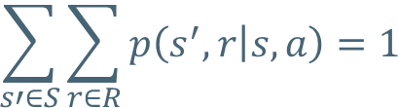
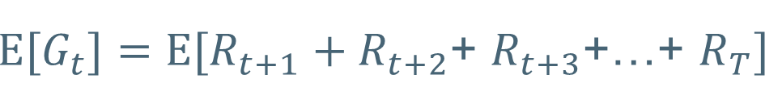
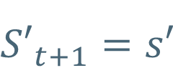
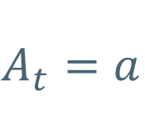
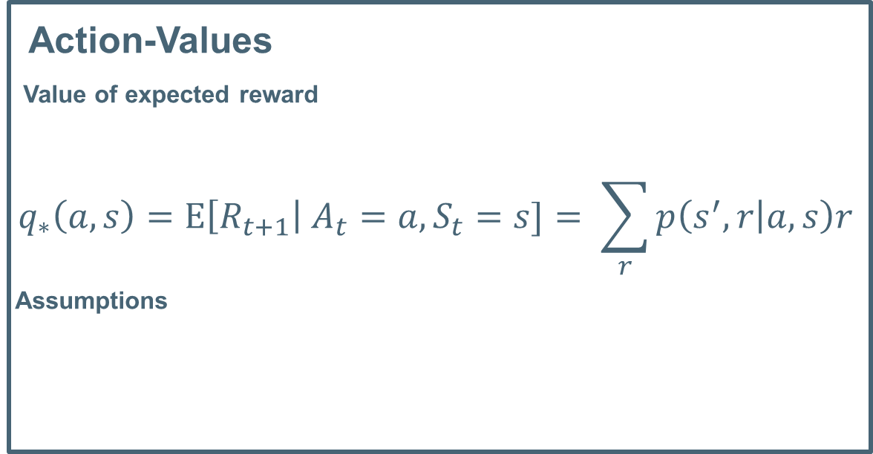
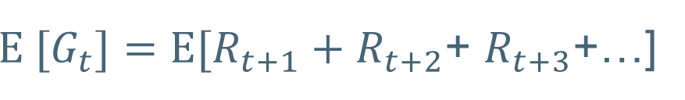

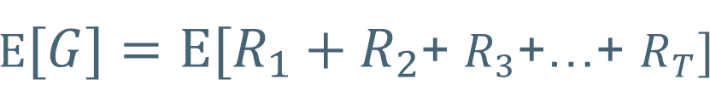
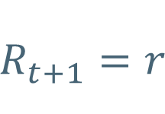
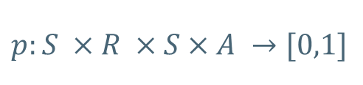
Markov Decision Process (MDP)
Action-Values
Value of expected reward
$$q_{∗}\left(a,s\right)=Ε\left[R_{t+1}\right| A_{t}=a,S_{t}=s]= \sum_{r}{p\left(s^{′},r | a,s\right)r}$$
Assumptions
$$S_{t}=s$$
$$A_{t}=a$$
$$\sum_{s′∈S}{\sum_{r∈R}{p\left(s^{′},r | s,a\right)}=1}$$
$$R_{t+1}=r$$
$$p:S ×R ×S×A →[0,1]$$
$${S′}_{t+1}=s′$$
$Ε[G]={Ε[R}_{1}+R_{2}$+ $R_{3}$+…+ $R_{T}]$
Maximize
Maximize
${Ε[G}_{t}]={Ε[R}_{t+1}+R_{t+2}$+ $R_{t+3}$+…+ $R_{T}]$
$Ε [G_{t}]=Ε[R_{t+1}+R_{t+2}$+ $R_{t+3}$+…]
The present state contains all information necessary to predict the future
Notes:
Markov chains are an important concept in stochastic processes. They can be used to greatly simplify processes that satisfy the Markov property, namely that the future state of a stochastic variable is only dependent on its present state. This means that knowing the previous history of the process will not improve the future predictions - which of course significantly reduces the amount of data that needs to be taken into account. Mathematically, Markov chains consist of a state space, which is a vector whose elements are all the possible states of a stochastic variable, the present state of the variable, and the transition matrix. The transition matrix contains all the probabilities that the variable will transition from one state to another, or remain the same. To calculate the probabilities of a variable ending up in certain states after n discrete partitions of time, one simply multiplies the present state vector with the transition matrix raised to the power of n.

Slide 12
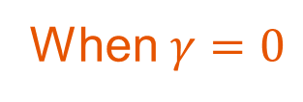
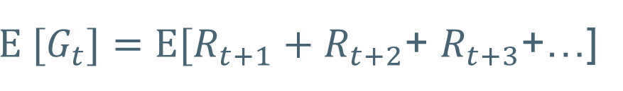

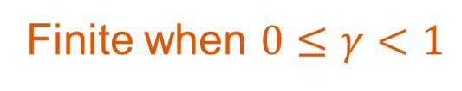
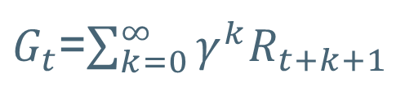
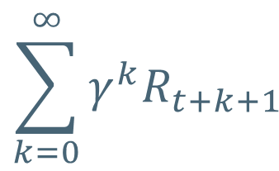
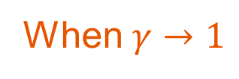
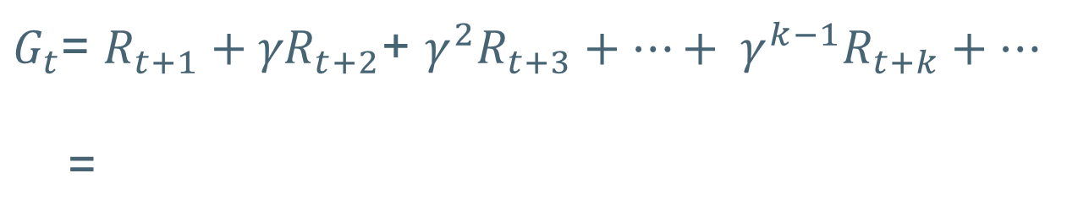
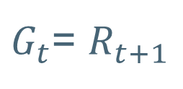
Markov Decision Process (MDP)
Maximize
$Ε [G_{t}]=Ε[R_{t+1}+R_{t+2}$+ $R_{t+3}$+…]
Apply discounting to future rewards, $γ$
$G_{t}$= $R_{t+1}+{γR}_{t+2}$+ $γ^{2}R_{t+3}+…+ γ^{k−1}R_{t+k}+…$
=
$$\sum_{k=0}^{∞}{γ^{k}R_{t+k+1}}$$
Finite when $0≤γ<1$
When $γ=0$
$G_{t}$= $R_{t+1}$
Cares only about immediate reward
When $γ→1$
$G_{t}$=$\sum_{k=0}^{∞}{γ^{k}R_{t+k+1}}$
Accounts for future reward strongly

Slide 13
Policies & Bellman Equations

Slide 14



How to specify a policy
Definition
Policy is a distribution over actions for each state
Types of Policies
Deterministic Policy
A policy that maps each state to a single action.
Stochastic Policy
A policy that maps each state to probability distributions of each actions.
E.g. Neural Network policy: probability distributions for each action created using a neural network
Neural Network policy
$\sum_{a∈A}{π\left(a | s\right)}=$1 $π\left(a | s\right)≥0$
Each state includes all the information required for decision-making. (e.g. cannot include time or previous state actions)
Notes:
A policy maps each state to a distribution of action.

Slide 15



State-value function & Action-value functions in a policy
State-value function $v_{π}\left(s\right)$
Expected return from a given state under a specific policy.
Action-value function $q_{π}\left(s,a\right)$
Expected return from a given state after taking a specific action, following a specific policy.
$$G_{t}= \sum_{k=0}^{T}{γ^{k}R_{t+k+1}}$$
$$v_{π}\left(s\right)= Ε_{π}\left[G_{t}\right| S_{t}=s], ∀s∈S$$
$q_{π}\left(s,a\right)= Ε_{π}\left[G_{t}\right| S_{t}=s,A_{t}=a]$, $∀s∈S, ∀a∈A$
How?
Value functions enable us to query the quality of the current situation
under a specific policy without waiting for the long-term outcome.
Notes:
value function represent how good is a state for an agent to be in. It is equal to expected total reward for an agent starting from state s. The value function depends on the policy by which the agent picks actions to perform.
Q is a function of a state-action pair and returns a real value.
Q(s, a) is an indication for how good it is for an agent to pick action a while being in state s
Suppose we define the game of chess as a reward with +1 for winning and 0 for all the other moves. This reward does not tell us much about how well the agent is playing during the match, and when we apply a policy, we'll have to wait until the end of the game to see any non-zero reward. We have to wait til the end of the game to understand if the policy is useful.
With the value functions, we can now assess the quality of the policy at every time step.
The state value is equal to the expected sum of future rewards. Since we structure the reward of winning as +1 and all other outcomes as 0, the state value is simply the probability of winning if we follow the current policy. By using the state value function, we can find out the probability of winning under the policy at any given state.
Action value function is the expected return from a given state after taking a specific action. This would allow us to assess the probability of winning for each possible move given we follow a specific policy for the rest of the game.
In RL, the return/output is not immediately available and second, the return may be random due to stochasticity in both the policy and environment dynamics. The value function summarizes all the possible futures by averaging over returns. Now we don’t have to wait until the end of the game to judge the quality of different policies.

Slide 16

Bellman Equation
connect the value of a state and value of future states
Using,
recursive relationship
the property that action choices only depend on the current state
next state action and reward only depends on the current state and action
Neither policy nor p depends on time
State-value Bellman Equation
$${Since G}_{t}= \sum_{k=0}^{∞}{γ^{k}R_{t+k+1}}$$
$$v_{π}\left(s\right)= Ε_{π}\left[G_{t}\right| S_{t}=s], ∀s∈S$$
$= Ε_{π}\left[R_{t}+γG_{t+1}\right| S_{t}=s]$
$={ Ε}_{π}\left[R_{t}\right| S_{t}=s]+Ε_{π}\left[γG_{t+1}\right| S_{t}=s]$
$= \sum_{a}{π\left(a | s\right)\sum_{s^{′}}{\sum_{r}{p\left(s^{′},r | s,a\right)[r+γΕ_{π}\left[G_{t+1}\right| S_{t+1}=s^{′}]}}}$
$= \sum_{a}{π\left(a | s\right)\sum_{s^{′}}{\sum_{r}{p\left(s^{′},r | s,a\right)[r+γv_{π}\left(s^{′}\right)]}}}$
Notes:
Recall that the return is defined as the discounted sum of future rewards. We saw previously that the return at time t, can be written recursively as the immediate reward plus the discounted return at time t plus 1. Now, let's expand this expected return. First, we expand the expected return as a sum over possible action choices made by the agent. Second, we expand over possible rewards and next states condition on state S and action a.
We can break it down in this order because the action choice depends only on the current state, while the next state and reward depend only on the current state and action.
The result is a weighted sum of terms consisting of immediate reward plus expected future returns from the next state S prime.
All we have done is explicitly write the expectation as it's defined, as a sum of possible outcomes weighted by the probability that they occur. Note that capital R_t plus 1 is a random variable, while little R represents each possible reward.
The expected return depends on states and rewards infinitely far into the future. We could recursively expand this equation as many times as we want, but it would only make the expression more complicated. Instead, we can notice that this expected return is also the definition of the value function for state S prime. The only difference is that the time index is t plus 1 instead of t. This is not an issue because neither the policy nor p depends on time.
Making this replacement, we get the Bellman equation for the state value function. The magic of value functions is that we can use them as a stand-in for the average of an infinite number of possible futures.

Slide 17
Action-value Bellman Equation
$$q_{π}\left(s,a\right)= Ε_{π}\left[G_{t}\right| S_{t}=s,A_{t}=a], ∀s∈S$$
$=$ $\sum_{s^{′}}{\sum_{r}{p\left(s^{′},r | s,a\right)[r+γΕ_{π}\left[G_{t+1}\right| S_{t+1}=s^{′}]]}}$
$=$ $\sum_{s^{′}}{\sum_{r}{p\left(s^{′},r | s,a\right)[r+γ\sum_{a^{′}}{π\left(a^{′} | s^{′}\right)}Ε_{π}\left[G_{t+1}\right| S_{t+1}=s^{′},A_{t+1}=a^{′}]}}$
$=$ $\sum_{s^{′}}{\sum_{r}{p\left(s^{′},r | s,a\right)[r+γ\sum_{a^{′}}{π\left(a^{′} | s^{′}\right)}q_{π}(s^{′},a^{′})]]}}$
Bellman equations help us to compute the value functions
Create bellman equation for each state -> System of linear equations
Solving system of equations -> solve for state values
Notes:
We can derive a similar equation for the action value function. It will be a recursive equation for the value of a state action pair in terms of its possible successors state action pairs. In this case, the equation does not begin with the policy selecting an action. This is because the action is already fixed as part of the state action pair. Instead, we skip directly to the dynamics function p to select the immediate reward and next state S prime.
Again, we have a weighted sum over terms consisting of immediate reward plus expected future return given a specific next state little s prime. However, unlike the Bellman equation for the state value function, we can't stop here. We want to recursive equation for the value of one state action pair in terms of the next state action pair. At the moment, we have the expected return given only the next state.
To change this, we can express the expected return from the next state as a sum of the agents possible action choices. In particular, we can change the expectation to be conditioned on both the next state and the next action and then sum over all possible actions. Each term is weighted by the probability under Pi of selecting A prime in the state S prime.
Now, this expected return is the same as the definition of the action value function for S prime and A prime. Making this replacement, we get the Bellman equation for the action value function.

Slide 18


Optimal policy
An optimal policy $π_{∗}$ is defined as a policy where
$v_{π_{∗}}\left(s\right)≥v_{π}\left(s\right) ∀s∈S, ∀ policies π$
Expected return is greater than or equal to any other policy for all states.
There exists at least 1 optimal policy for every MDP
Recall, the state value function is
$$v_{π}\left(s\right)= Ε_{π}\left[G_{t}\right| S_{t}=s], ∀s∈S$$
An optimal value function has a higher value than all other possible value functions for every state
$$v^{∗}\left(s\right)=\max_{π}{v^{π}(s)}, ∀s∈S$$
Recall, the action value function is
$q_{π}\left(s,a\right)= Ε_{π}\left[G_{t}\right| S_{t}=s,A_{t}=a]$, $∀s∈S, ∀a∈A$
$$q_{π_{∗}}\left(s,a\right)=\max_{π}{q_{π}\left(s,a\right), ∀s∈S,∀a∈A}$$
Notes:
value function represent how good is a state for an agent to be in. It is equal to expected total reward for an agent starting from state s. The value function depends on the policy by which the agent picks actions to perform.
Among all possible value-functions, there exist an optimal value functionthat has higher value than other functions for all states.
Q is a function of a state-action pair and returns a real value.
Q*(s, a) is an indication for how good it is for an agent to pick action a while being in state s
V*(s) is the maximum expected total reward when starting from state s , it will be the maximum of Q*(s, a)over all possible actions.
If we know the optimal Q-function Q*(s, a) , the optimal policy can be easily extracted by choosing the action a that gives maximum Q*(s, a) for state s.

Slide 19




Relationship of state and action value functions in optimal policy
$$v^{∗}\left(s\right)=\max_{π}{v^{π}(s)}, ∀s∈S$$
$$q^{∗}\left(s,a\right)=\max_{π}{q_{π}\left(s,a\right), ∀s∈S,∀a∈A}$$
$$v^{∗}\left(s\right)=\max_{π}{q^{∗}\left(s,a\right), ∀a∈A}$$
$$π^{∗}\left(s\right)=\underset{π}{argmax}{v^{π}(s)}, ∀s∈S$$
$$π^{∗}\left(s\right)=\underset{a}{argmax}{q^{∗}(s,a)}, ∀s∈S$$
optimal policy 𝛑* is the policy that corresponds to optimal value function.
Notes:
value function represent how good is a state for an agent to be in. It is equal to expected total reward for an agent starting from state s. The value function depends on the policy by which the agent picks actions to perform.
Among all possible value-functions, there exist an optimal value function that has higher value than other functions for all states.
Q is a function of a state-action pair and returns a real value.
Q*(s, a) is an indication for how good it is for an agent to pick action a while being in state s
V*(s) is the maximum expected total reward when starting from state s , it will be the maximum of Q*(s, a)over all possible actions.
If we know the optimal Q-function Q*(s, a) , the optimal policy can be easily extracted by choosing the action a that gives maximum Q*(s, a) for state s.

Slide 20


Bellman Optimality Equation

Slide 21







Determining an Optimal policy $π^{∗}$ from $v^{∗}$
$$current state:s$$
$$v^{∗}\left(s\right)=\max_{a}{\sum_{s^{′}}{\sum_{r}{p\left(s^{′},r | s,a\right)[r+γv^{∗}\left(s^{′}\right)]}}}$$
$$A_{1}$$
$$A_{2}$$
$$A_{3}$$
$$π^{∗}\left(s\right)=\underset{a}{argmax}{\sum_{s^{′}}{\sum_{r}{p\left(s^{′},r | s,a\right)[r+γv^{∗}\left(s^{′}\right)]}}}$$
$${next state:s}^{′}$$
Notes:
In general, having v star makes it relatively easy to work out the optimal policy as long as we also have access to the dynamics function p. For any state, we can look at each available action and evaluate the boxed term. There will be some action for which this term obtains a maximum.
A deterministic policy which selects this maximizing action for each state will necessarily be optimal, since it obtains the highest possible value. The equation shown here for pi star is thus almost the same as the Bellman optimality equation for v star.
v star is equal to the maximum of the boxed term over all actions. Pi star is the argmax, which simply means the particular action which achieves this maximum. To evaluate the boxed term for a given action, we need only perform a one step look ahead at the possible next states and rewards that follow. First, imagine doing so for particular action, labeled A1. We look at each state and reward which may follow from state s after taking action a1. Since we have access to v star and p, we can then evaluate each term in the sum over s’ and r.
let's say that for A1, the boxed term evaluates to 5. We can repeat the same procedure for A2. Again, this requires only a one step look ahead thanks to having access to v star. Let's say in this case we find a result of 10. Finally for A3, let's say we obtain a result of 7. Of these three actions, A2 maximizes the boxed term with a value of 10. This means that A2 is the optimal action.

Slide 22

Determining an Optimal policy $π^{∗}$ from $q^{∗}$
$$π^{∗}\left(s\right)=\underset{a}{argmax}{q^{∗}(s,a)}$$
$$A_{1}$$
$$A_{2}$$
$$A_{3}$$
Notes:
if instead we have access to q star, it's even easier to come up with the optimal policy. In this case, we do not have to do a one step look ahead at all. We only have to select any action a, that maximizes q star of s and a. The action-value function caches the results of a one-step look ahead for each action. In this sense, the problem of finding an optimal action-value function corresponds to the goal of finding an optimal policy.

Slide 23
Policy Evaluation, Policy Control, Policy Iteration

Slide 24
Policy Evaluation
Definition
Policy evaluation is the task of determining the value function for a specific policy.
Policy Control
Definition
Policy Control is the task to find a policy maximizes the reward, that is, the optimal policy which maximizes the value function.
1.
2.
3.
MDP problem
definition
Policy
Evaluation
Policy
Control
Value function definition Bellman equation creates a system of linear eqn
Use Dynamic Programming

Slide 25





Policy Evaluation
Definition
Policy evaluation is the task of determining the value function for a specific policy.
$$v_{π}\left(s\right)= Ε_{π}\left[G_{t}\right| S_{t}=s], ∀s∈S$$
Using state-value Bellman equation,
$$v_{π}\left(s\right)= \sum_{a}{π\left(a | s\right)\sum_{s^{′}}{\sum_{r}{p\left(s^{′},r | s,a\right)[r+γv_{π}\left(s^{′}\right)]}}}$$
Applying Bellman equation to each state gives us a system of linear equation,
$$π,p,γ$$
Linear System Solver
$$v_{π}$$
High computational cost
Bellman equation
State values
$$π,p,γ$$
Dynamic Programming
$$v_{π}$$

Slide 26




Iterative Policy Evaluation (Dynamic Programming)
By Bellman equation, let $v_{π}\left(s\right)$ be the true state-value function
$$v_{π}\left(s\right)= \sum_{a}{π\left(a | s\right)\sum_{s^{′}}{\sum_{r}{p\left(s^{′},r | s,a\right)[r+γv_{π}\left(s^{′}\right)]}}}$$
$$v_{k+1}\left(s\right)←v_{k}\left(s\right)$$
directly use Bellman function as an update rule
$$\lim_{k→ ∞}{v_{k}=v_{π}}$$
Notes:
When we have information on the environment’s dynamics, that is the p(s’,r|s,a) then by the bellman equation this resolves to a system of |S| simultaneous linear equations in |S| unknowns (the v_pi(s), s in S). In principle, its solution
is a straightforward, if tedious, computation.
Instead of solving the system of linear equations directly, we use dynamic programming. Which is an iterative method, of approximating the v_pi over multiple times whereby each step gives us a closer approximation to the actual v_pi
Consider a sequence of approximate value functions v0, v1, v2,. . ., each S+ space mapping to real value space (the real numbers).
The initial approximation, v0, is chosen arbitrarily (except that the terminal state, if any, must be given value 0), and each successive approximation is obtained by using the Bellman equation for
v_pi using the following update rule:
for all s in S. Clearly, v_k = v_pi is a fixed point for this update rule because the Bellman equation for v_pi assures us of equality in this case. Indeed, the sequence {vk} can be
shown in general to converge to v_pi as k goes to infinity under the same conditions that guarantee the existence of v_pi. This algorithm is called iterative policy evaluation.
To produce each successive approximation, vk+1 from vk, iterative policy evaluation applies the same operation to each state s: it replaces the old value of s with a new value obtained from the old values of the successor states of s, and the expected immediate rewards, along all the one-step transitions possible under the policy being evaluated. We call this kind of operation an expected update. Each iteration of iterative policy evaluation updates the value of every state once to produce the new approximate value function
Dynamic programming algorithms are obtained by turning the Bellman equations into update rules.
We take the Bellman equation and directly use it as an update rule. Now, instead of an equation which holds for the true value function, we have a procedure we can apply to iteratively refine our estimate of the value function. This will produce a sequence of better and better approximations to the value function.

Slide 27






Iterative Policy Evaluation (Dynamic Programming)
$$S_{1}$$
$$S_{2}$$
1 Full sweep
$$S_{3}$$
$$S_{4}$$
Largest update of the state value in a given iteration
Notes:
To implement iterative policy evaluation, we store two arrays, each has one entry for every state. One array, which we label V stores the current approximate value function. Another array, V prime, stores the updated values. By using two arrays, we can compute the new values from the old one state at a time without the old values being changed in the process.
At the end of a full sweep, we can write all the new values into V; then we do the next iteration.
track the largest update to this state value in a given iteration. Let's call this delta.

Slide 28





Policy Control (Policy Improvement Theorem)
To find the optimal policy, we find the policy that maximizes Bellman’s equation at every state
$$π_{∗}\left(s\right)=\underset{a}{argmax}{\sum_{s^{′}}{\sum_{r}{p\left(s^{′},r | s,a\right)[r+γv_{∗}\left(s^{′}\right)]}}}$$
$$π^{∗}\left(s\right)=\underset{a}{argmax}{q^{∗}(s,a)}$$
Instead of w.r.t $v_{∗}\left(s^{′}\right)$ we use $v_{π}\left(s^{′}\right)$ for some policy $π$
$$v^{∗}\left(s\right)=\max_{π}{q^{∗}\left(s,a\right), ∀a∈A}$$
$$π^{′}\left(s\right)=\underset{a}{argmax}{\sum_{s^{′}}{\sum_{r}{p\left(s^{′},r | s,a\right)[r+γv_{π}\left(s^{′}\right)]}}}$$
This new policy $π^{′}$ must be different from$π$
Else, $π$ is already argmax to its own value function → $π$ obeys the Bellman’s optimality equation and is the optimal policy
Notes:
Previously, we showed that given v star, we can find the optimal policy by choosing the Greedy action. The Greedy action maximizes the Bellman's optimality equation in each state. Imagine instead of the optimal value function, we select an action which is greedy with respect to the value function v Pi of an arbitrary policy Pi. What can we say about this new policy? That it is greedy with respect to v Pi.
The first thing to note is that this new policy must be different than Pi. If this greedification doesn't change Pi, then Pi was already greedy with respect to its own value function. This is just another way of saying that v Pi obeys the Bellman's optimality equation. In which case, Pi is already optimal. In fact, the new policy obtained in this way must be a strict improvement on Pi, unless Pi was already optimal.

Slide 29

Policy Control (Policy Improvement Theorem)
Further, the new policy $π^{′}$ is a strict improvement over $π$ unless $π$ is optimal policy
Policy Improvement Theorem
$q_{π}\left(s,π^{′}(s)\right)≥q_{π}\left(s,π\left(s\right)\right) for all s∈S →π^{′}≥ π$
$$q_{π}\left(s,π^{′}(s)\right)>q_{π}\left(s,π\left(s\right)\right) for at least one s∈S →π^{′}> π$$
The new policy is a strict improvement over $π$ $Multiple iterations maybe needed to obtain π^{∗}$optimal policy
Notes:
The policy improvement theorem formalizes this idea. Policy Pi prime is at least as good as Pi if in each state, the value of the action selected by Pi prime is greater than or equal to the value of the action selected by Pi. Policy pi prime is strictly better if the value is strictly greater and at least one state.

Slide 30

Policy Control (Policy Iteration algorithm)
Policy Evaluation
Policy Improvement
$π_{3}$> $π_{2}$
E
I
E
I
E
I
E
I
E
I
$π_{1}$ $→$ $V_{π_{1}}→ π_{2}→V_{π_{2}}→π_{3}→V_{π_{3}}→…→ π_{∗}→V_{π_{∗}}{→ π}_{∗}→V_{π_{∗}}$
No changes. Optimal policy achieved
Deterministic. Hence, finite number of steps
Notes:
Let's say we begin with the policy Pi 1. We can evaluate Pi 1 using iterative policy evaluation to obtain the state value, V Pi 1. We call this the evaluation step. Using the results of the policy improvement theorem, we can then greedify with respect to v Pi 1 to obtain a better policy, Pi 2. We call this the improvement step. We can then compute V Pi 2 and use it to obtain an even better policy, Pi 3. This gives us a sequence of better policies.
Each policy is guaranteed to be an improvement on the last unless the last policy was already optimal. So when we complete an iteration, and the policy remains unchanged, we know we have found the optimal policy. At that point, we can terminate the algorithm.
Each policy generated in this way is deterministic. There are finite number of deterministic policies, so this iterative improvement must eventually reach an optimal policy. This method of finding an optimal policy is called policy iteration.

Slide 31

Policy Control (Policy Iteration algorithm)
If policy-stable → false, the policy is still changing
Notes:
We initialize v and Pi in any way we like for each state s. Next, we call iterative policy evaluation to make V reflect the value of Pi. This is the algorithm we learned earlier in this module. Then, in each state, we set Pi to select the maximizing action under the value function. If this procedure changes the selected action in any state, we note that the policy is still changing, and set policy stable to false. After completing step 3, we check if the policy is stable. If not, we carry on and evaluate the new policy

Slide 32
Monte Carlo methods

Slide 33
What is Monte Carlo Simulation?
Method of estimating the value of unknown quantity using inferential statistics
Inferential statistics
Population: the universe of observations
Sample: a subset of the population
Key fact: a random sample tends to exhibit the same properties as the population from which it is drawn
Similar to Random walk
Notes:
It’s a method of measuring the value of unknown quantiy
Population: as a universe of all possible observations
Make an inference from the Random Sample from the population based on some set of statistic we apply on the random sample.
Exactly like the random walk,
With large number of 10,000 steps, there is a large number of possible walks with 10,000 steps
We take a random sample of 100 steps and take its mean to infer
Monte Carlo methods sample and average returns for each state–action pair much like
the bandit methods we explored in Chapter 2 sample and average rewards for each action.
The main difference is that now there are multiple states, each acting like a different
bandit problem (like an associative-search or contextual bandit) and the different bandit
problems are interrelated. That is, the return after taking an action in one state depends
on the actions taken in later states in the same episode. Because all the action selections
are undergoing learning, the problem becomes nonstationary from the point of view of
the earlier state.
Whereas there we computed value functions from knowledge
of the MDP, here we learn value functions from sample returns with the MDP. The value
functions and corresponding policies still interact to attain optimality in essentially the
same way (GPI). As in the DP chapter, first we consider the prediction problem (the
computation of v⇡ and q⇡ for a fixed arbitrary policy ⇡) then policy improvement, and,
finally, the control problem and its solution by GPI. Each of these ideas taken from DP
is extended to the Monte Carlo case in which only sample experience is available.

Slide 34
Why use Monte Carlo?
Learn optimal policy directly from experience
Experience: interaction w environment.
No model of environment dynamics needed
Used with simulation or sample models
Sample transition probabilities instead of explicit model of transition probabilities
Focus on a small subset of states
without at the expense of accurately evaluating the rest of the state set
Less violations of the Markov property
Notes:
Monte Carlo methods presented in this chapter learn value functions and optimal policies from experience in the form of sample episodes.
This gives them at least three kinds of advantages over DP methods.
First, they can be used to learn optimal behavior directly from interaction with the environment, with no model of the environment’s dynamics.
Second, they can be used with simulation or sample models. For surprisingly many applications it is easy to simulate sample episodes even though it is difficult to construct the kind of explicit model of transition probabilities required by DP methods.
Third, it is easy and efficient to focus Monte Carlo methods on a small subset of the states. A region of special interest can be accurately evaluated without going to the expense of accurately evaluating the rest of the state set (we explore this further in Chapter 8).
A fourth advantage of Monte Carlo methods, which we discuss later in the book, is that they may be less harmed by violations of the Markov property. This is because they do not update their value estimates on the basis of the value estimates of successor states. In other words, it is because they do not bootstrap.

Slide 35
How is Monte Carlo used in RL?
MC calculating returns (Policy Evaluation)
First-visit MC, Every Visit MC (Policy Evaluation)
MC Exploring Starts (Policy Control)
MC Epsilon Greedy (Policy Control)

Slide 36


Monte Carlo Prediction of Value state function (First-Visit)
E
$π_{1}$ $→$ $V_{π_{1}}$
Every-visit MC algorithm would be the same except without the check for $S_{t}$ having occurred earlier in the episode.
Notes:
We begin by considering Monte Carlo methods for learning the state-value function for a
given policy. Recall that the value of a state is the expected return—expected cumulative
future discounted reward—starting from that state. An obvious way to estimate it from
experience, then, is simply to average the returns observed after visits to that state. As
more returns are observed, the average should converge to the expected value. This idea
underlies all Monte Carlo methods.
In particular, suppose we wish to estimate V_pi(s), the value of a state s under policy pi given a set of episodes obtained by following pi and passing through s. Each occurrence
of state s in an episode is called a visit to s. Of course, s may be visited multiple times in the same episode; let us call the first time it is visited in an episode the first visit
to s. The first-visit MC method estimates
V_pi(s) as the average of the returns following first visits to s, whereas the every-visit MC method averages the returns following all visits to s.
First-visit MC has been most widely studied, dating back to the 1940s, and is the one we focus on in this chapter. Every-visit MC extends more naturally to function approximation and eligibility traces.
Both first-visit MC and every-visit MC converge to v_pi(s) as the number of visits (or first visits) to s goes to infinity
This is easy to see for the case of first-visit MC. In
this case each return is an independent, identically distributed estimate of
V_pi(s) with finite variance. By the law of large numbers the sequence of averages of these estimates
converges to their expected value. Each average is itself an unbiased estimate, and the standard deviation of its error falls as 1/sqrt(n)
where n is the number of returns averaged. Every-visit MC is less straightforward, but its estimates also converge quadratically to
V_pi(s) (Singh and Sutton, 1996).

Slide 37










Monte Carlo Prediction of Action value function
Expected return starting in stare $s$, taking action $a$
$$q_{π}(s,a)$$
E
$π_{1}$ $→$ $V_{π_{1}}$
$$V(s,a)$$
$$, a∈A$$
$$, a∈A$$
Episode: each game of chess, trial etc
$(s,a$)
$$Unless \left(s_{t},a_{t}\right) apears in S_{0}, A_{0}, S_{1}, A_{1},…,S_{t−1}, A_{t−1}:$$
$Returns(S_{t},A_{t}$)
$V(S_{t},A_{t})←average(Returns(S_{t},A_{t}$))
Problem: many state-action pairs may never be visited. If $π$ is a deterministic policy, then will only observe one deterministic action for each state. No exploration of state-action pairs, no returns to average, MC will not improve with experience.
Notes:
If a model is not available, then it is particularly useful to estimate action values (the
values of state–action pairs) rather than state values. With a model, state values alone are
sufficient to determine a policy; one simply looks ahead one step and chooses whichever
action leads to the best combination of reward and next state, as we did in the chapter on
DP
Without a model, however, state values alone are not sufficient. One must explicitly
estimate the value of each action in order for the values to be useful in suggesting a policy.
Thus, one of our primary goals for Monte Carlo methods is to estimate
q_*
To achieve this, we first consider the policy evaluation problem for action values.
The policy evaluation problem for action values is to estimate
q_pi(s,a) the expected return when starting in state s, taking action a, and thereafter following policy pi. The
Monte Carlo methods for this are essentially the same as just presented for state values, except now we talk about visits to a state–action pair rather than to a state.
A state–action pair s, a is said to be visited in an episode if ever the state s is visited and action
a is taken in it. The every-visit MC method estimates the value of a state–action pair
as the average of the returns that have followed all the visits to it. The first-visit MC
method averages the returns following the first time in each episode that the state was
visited and the action was selected. These methods converge quadratically, as before, to
the true expected values as the number of visits to each state–action pair approaches
Infinity
The only complication is that many state–action pairs may never be visited. If ⇡ is
a deterministic policy, then in following ⇡ one will observe returns only for one of the
actions from each state. With no returns to average, the Monte Carlo estimates of the
other actions will not improve with experience. This is a serious problem because the
purpose of learning action values is to help in choosing among the actions available in
each state. To compare alternatives we need to estimate the value of all the actions from
each state, not just the one we currently favor.

Slide 38
Monte Carlo Prediction of Action value function
To assure continual exploration. We use the assumption: Exploring starts
Specify that the episodes start in a state–action pair, and that every pair has a nonzero probability of being selected as the start.
Designing a stochastic policy with a nonzero probability of selecting all actions in each state
Notes:
This is the general problem of maintaining exploration, as discussed in the context
of the k-armed bandit problem in Chapter 2. For policy evaluation to work for action
values, we must assure continual exploration. One way to do this is by specifying that
the episodes start in a state–action pair, and that every pair has a nonzero probability of
being selected as the start. This guarantees that all state–action pairs will be visited an
infinite number of times in the limit of an infinite number of episodes. We call this the
assumption of exploring starts.
The assumption of exploring starts is sometimes useful, but of course it cannot be
relied upon in general, particularly when learning directly from actual interaction with an
environment. In that case the starting conditions are unlikely to be so helpful. The most
common alternative approach to assuring that all state–action pairs are encountered is to consider only policies that are stochastic with a nonzero probability of selecting all
actions in each state. We discuss two important variants of this approach in later sections.
For now, we retain the assumption of exploring starts and complete the presentation of a
full Monte Carlo control method.

Slide 39



Monte Carlo Exploring Starts (Policy Control)
$$q_{π}\left(s,π^{′}(s)\right)≥q_{π}\left(s,π\left(s\right)\right)$$
Follows with the Generalized Policy Improvement algorithm:
In GPI, we maintain both an approximate policy and
an approximate value function.
The value function is repeatedly altered to more closely approximate the value function for the current policy, and the policy is repeatedly improved with respect to the current value function.
$$π′\left(s\right)= \underset{a}{argmax}{q_{π}(s,a)}$$
E
I
E
I
E
I
E
I
E
I
$π_{1}$ $→$ $V_{π_{1}}→ π_{2}→V_{π_{2}}→π_{3}→V_{π_{3}}→…→ π_{∗}→V_{π_{∗}}{→ π}_{∗}→V_{π_{∗}}$
In the case we have action-value function, no model is required to greedify the policy
Assumption 1: Episodes have exploring starts
Assumption 2: Policy evaluation can be done with an infinite number of episodes
Notes:
The overall idea is to proceed according to the same
pattern as in the DP chapter, that is, according to the idea of generalized policy iteration (GPI). In GPI one maintains both an approximate policy and
an approximate value function. The value function is repeatedly
altered to more closely approximate the value function for the
current policy, and the policy is repeatedly improved with respect
to the current value function, as suggested by the diagram to
the right. These two kinds of changes work against each other to
some extent, as each creates a moving target for the other, but
together they cause both policy and value function to approach
optimality.
we perform alternating complete steps of policy evaluation and policy
improvement, beginning with an arbitrary policy $π_{0}$ and ending with the optimal policy and optimal action-value function:
For the moment, let us assume that we do indeed
observe an infinite number of episodes and that, in addition, the episodes are generated
with exploring starts. Under these assumptions, the Monte Carlo methods will compute
Each q_pi_k exactly, for arbitrary pi_k
As we discussed in the previous chapter, the theorem assures us that each .
is uniformly pi_k+1
better than pi_k,
or just as good as pi_k, in which case they are both optimal policies. This in turn assures us that the overall process converges to the optimal policy and optimal
value function. In this way Monte Carlo methods can be used to find optimal policies
given only sample episodes and no other knowledge of the environment’s dynamics.
One was that the episodes have exploring
starts, and the other was that policy evaluation could be done with an infinite number of
episodes. To obtain a practical algorithm we will have to remove both assumptions

Slide 40

Monte Carlo Exploring Starts (Policy Control)
Notes:
For now we focus on the assumption that policy evaluation operates on an infinite
number of episodes. This assumption is relatively easy to remove. In fact, the same issue
arises even in classical DP methods such as iterative policy evaluation, which also converge
only asymptotically to the true value function.
There is an approach to avoiding the infinite number of episodes nominally required for policy evaluation, in which we give up trying to complete policy evaluation
before returning to policy improvement. On each evaluation step we move the value
function toward q_pi_k, but we do not expect to actually get close except over many steps.
We used this idea when we first introduced the idea of GPI in Section 4.6. One extreme
form of the idea is value iteration, in which only one iteration of iterative policy evaluation
is performed between each step of policy improvement. The in-place version of value
iteration is even more extreme; there we alternate between improvement and evaluation
steps for single states.

Slide 41


Monte Carlo Exploring Starts (Policy Control)
Removing the 2nd assumption on infinite number of episodes for policy evaluation
Relax $∆$ to avoid trying to complete policy evaluation before going to policy improvement. Extreme case: Perform only 1 iteration (value iteration algorithm)
Notes:
For now we focus on the assumption that policy evaluation operates on an infinite
number of episodes. This assumption is relatively easy to remove. In fact, the same issue
arises even in classical DP methods such as iterative policy evaluation, which also converge
only asymptotically to the true value function.
There is an approach to avoiding the infinite number of episodes nominally required for policy evaluation, in which we give up trying to complete policy evaluation
before returning to policy improvement. On each evaluation step we move the value
function toward q_pi_k, but we do not expect to actually get close except over many steps.
We used this idea when we first introduced the idea of GPI in Section 4.6. One extreme
form of the idea is value iteration, in which only one iteration of iterative policy evaluation
is performed between each step of policy improvement. The in-place version of value
iteration is even more extreme; there we alternate between improvement and evaluation
steps for single states.

Slide 42
Monte Carlo Non-exploring Starts (Policy Control)
Removing the 1st assumption on Exploring Starts
The only way to ensure all action-state pairs are visited is for the agent to continue to select all action-state pairs
2 approaches
On-policy
Off-policy
Notes:
How can we avoid the unlikely assumption of exploring starts? The only general way to
ensure that all actions are selected infinitely often is for the agent to continue to select
them.
There are two approaches to ensuring this, resulting in what we call on-policy
methods and o.-policy methods. On-policy methods attempt to evaluate or improve the
policy that is used to make decisions, whereas off-policy methods evaluate or improve
a policy different from that used to generate the data. The Monte Carlo ES method
developed above is an example of an on-policy method. In this section we show how an
on-policy Monte Carlo control method can be designed that does not use the unrealistic
assumption of exploring starts.

Slide 43



What is On-policy? Off-policy?
Agent
Behavioral policy:
$$β(s)$$
Policy Evaluation:
Learn action values conditional on subsequent optimal behavior
Critic: $V(s)$ or $Q(s,a)$
Policy Improvement:
Learn action values
Target policy:
Notes:
How can we avoid the unlikely assumption of exploring starts? The only general way to
ensure that all actions are selected infinitely often is for the agent to continue to select
them.
There are two approaches to ensuring this, resulting in what we call on-policy
methods and o.-policy methods. On-policy methods attempt to evaluate or improve the
policy that is used to make decisions, whereas off-policy methods evaluate or improve
a policy different from that used to generate the data. The Monte Carlo ES method
developed above is an example of an on-policy method. In this section we show how an
on-policy Monte Carlo control method can be designed that does not use the unrealistic
assumption of exploring starts.

Slide 44



On-policy Monte Carlo control
The on-policy approach is a compromise— it learns action values not for the optimal policy, but for a near-optimal policy such that the policy still explores.
That is probability $\frac{ε}{|A(s)|}$ for each of the non-greedy action
With probability $ε$ they instead select an action at random
Notes:
on-policy control methods the policy is generally soft, meaning that
pi(a| s) > 0 for all s in S and all a in A(s), but gradually shifted closer and closer to a deterministic optimal policy. Many of the methods discussed in Chapter 2 provide mechanisms for this. The on-policy method we present in this section uses eps-greedy policies, meaning that most of the time they choose an action that has maximal estimated action value, but with probability epsilon they instead select an action at random. That is, all nongreedy epsilon actions are given the minimal probability of selection,
Epsilon/(|A(s)|) and the remaining bulk of the probability, 1- epsilon + (epsilon)/|A(s)| is given to the greedy action. The epsilon-greedy policies are
examples of epsilon-soft policies, defined as policies for which pi(a|s) >= (epsilon)/|A(s)| for all states and actions, for some epsilon > 0. Among epsilon-soft policies, epsilon-greedy policies are in some sense those that are the closes to the greedy policy
The overall idea of on-policy Monte Carlo control is still that of GPI. As in Monte
Carlo ES, we use first-visit MC methods to estimate the action-value function for the
current policy. Without the assumption of exploring starts, however, we cannot simply
improve the policy by making it greedy with respect to the current value function, because
that would prevent further exploration of nongreedy actions. Fortunately, GPI does not
require that the policy be taken all the way to a greedy policy, only that it be moved
toward a greedy policy. In our on-policy method we will move it only to an "-greedy
policy. For any epsilon-soft policy, pi, any epsilon-greedy policy with respect to
q_pi is guaranteed to be better than or equal to pi The complete algorithm is given in the box below.

Slide 45

Off-policy Monte Carlo Methods
The off-policy approach uses 2 policies —1 policy (target policy) that is learned and becomes the optimal policy $π_{∗}$, the other policy (behavior policy) that is exploratory and used to generate samples.
Monte Carlo Policy Evaluation: Predict $v_{π} or q_{π}$, where (behavior policy) $b≠ π$ (target policy)
Episodes are generated from $b$. To use episodes from $b$ to estimate values $π.$ Every action taken under $π$ is also taken under $b.$ Need the assumption coverage: $π\left(a | s\right)>0$ implies $b\left(a | s\right)≻0$
Monte Carlo Policy Control: Predict $π_{∗}$
Usually deterministic greedy policy w.r.t current estimate of action-value function.
Since $b≠ π,$and we generate episodes from $b$, we have returns $G_{t}$ based on $b$
Hence, $E\left[G_{t} | S_{t}=s\right]=v_{b}\left(s\right)$
How do we get from $v_{b}\left(s\right) to v_{π}\left(s\right)$?
Importance Sampling!
Notes:
In this section we begin the study of off-policy methods by considering the prediction
problem, in which both target and behavior policies are fixed. That is, suppose we wish
to estimate v_pi or q_pi, but all we have are episodes following another policy b, where
b =/= pi. In this case, pi is the target policy, b is the behavior policy, and both policies are
considered fixed and given.
In order to use episodes from b to estimate values for pi, we require that every action
taken under pi is also taken, at least occasionally, under b. That is, we require that
pi(a|s) > 0 implies b(a|s) > 0. This is called the assumption of coverage.
It follows from coverage that b must be stochastic in states where it is not identical to pi. The
target policy pi, on the other hand, may be deterministic, and, in fact, this is a case
of particular interest in control applications. In control, the target policy is typically
the deterministic greedy policy with respect to the current estimate of the action-value
function. This policy becomes a deterministic optimal policy while the behavior policy
remains stochastic and more exploratory, for example, an epsilon-greedy policy.
Recall that we wish to estimate the expected returns (values) under the target policy,
but all we have are returns Gt due to the behavior policy. These returns have the wrong expectation
E[Gt | St = s] = v_b(s) and so cannot be averaged to obtain v_pi .
This is where importance sampling comes in. The ratio p_t: T-1 transforms the returns to have the right expected value:

Slide 46


Importance Sampling
Technique for estimating expected values under one distribution given samples from another
Gives us a way to sample quantities of interest for a given distribution $π$ given though we can’t directly sample from that distribution $π$
Given starting state $S_{t},$ the probability of subsequent state-action pairs, $A_{t}, S_{t_1}, A_{t+1},S_{t+2}…S_{T}$ occurring under any policy $π$ is
$$P\left\{A_{t}, S_{t_{1}}, A_{t+1},S_{t+2}…S_{T} \right| S_{t}, A_{t:T−1}\sim π\}$$
= $π\left(A_{t}\right|S_{t})p(S_{t+1}|S_{t},A_{t})π\left(A_{t+1}\right|S_{t+1})… p(S_{T}|S_{T−1},A_{T−1})$
= $\prod_{k=1}^{T−1}{π\left(A_{k}\right|S_{k})p\left(S_{k+1}|S_{k},A_{k}\right)}$
State transition probability
$p_{t:T−1}=\frac{\prod_{k=1}^{T−1}{π\left(A_{k}\right|S_{k})p\left(S_{k+1}|S_{k},A_{k}\right)}}{\prod_{k=1}^{T−1}{b\left(A_{k}\right|S_{k})p\left(S_{k+1}|S_{k},A_{k}\right)}}$ = $\frac{\prod_{k=1}^{T−1}{π\left(A_{k}\right|S_{k}) }}{\prod_{k=1}^{T−1}{b\left(A_{k}\right|S_{k}) }}$
Importance sampling ratio
Notes:
importance sampling, a general technique for estimating expected values under one distribution given samples from another. We apply
importance sampling to off policy learning by weighting returns according to the relative
probability of their trajectories occurring under the target and behavior policies, called
the importance-sampling ratio.
Given a starting state St, the probability of the subsequent
state–action trajectory, At, St+1,At+1, . . . ,ST , occurring under any policy pi is
where p here is the state-transition probability function defined by (3.4). Thus, the relative
probability of the trajectory under the target and behavior policies (the importance sampling
ratio) is
Although the trajectory probabilities depend on the MDP’s transition probabilities, which
are generally unknown, they appear identically in both the numerator and denominator,
and thus cancel. The importance sampling ratio ends up depending only on the two
policies and the sequence, not on the MDP
Recall that we wish to estimate the expected returns (values) under the target policy,
but all we have are returns Gt due to the behavior policy. These returns have the wrong expectation
E[Gt | St = s] = v_b(s) and so cannot be averaged to obtain v_pi .
This is where importance sampling comes in. The ratio p_t: T-1 transforms the returns to have the right expected value:

Slide 47


Off-policy Monte Carlo Evaluation
Estimation error
New estimate ← Old estimate + Step size*[Target – Old Estimate]
Importance sampling
Weighted average of the returns
$$W:weight for each corresponding G_{i}$$
$$C\left(S_{t}, A_{t}\right):cummulative sume of all weights$$
Notes:
This leaves the case of off-policy methods using weighted
importance sampling. Here we have to form a weighted average of the returns, and a
slightly different incremental algorithm is required.
Suppose we have a sequence of returns G1,G2,. . . Gn-1, all starting in the same state and each with a corresponding random weight
Wi (e.g.,Wi=p_ti:T(ti)-1). We wish to form the estimate of the average of returns Q(s_t, a_t) and keep it up to date
as we obtain a single additional return Gn. In addition to keeping track of Vn, we must maintain for each state the cumulative sum Cn of the weights given to the first n returns. The update rule for returns is
q(s_t,a_t) = q(s_t,a_t) + (W_n / C_n )*(G_n - q(s_t,a_t) )

Slide 48


Off-policy Monte Carlo Control
Based on General Policy Iteration algorithm
Ensure coverage assumption
Target policy $π$ greedy w.r.t. $Q$, which is an estimate to $q_{π}$
Notes:
Recall that the distinguishing feature of on-policy methods is that they estimate the value of a policy while using it for control. In off-policy methods these two functions are separated. The policy used to generate behavior, called the behavior policy, may in fact be unrelated to the policy that is evaluated and improved, called the target policy. An advantage of this separation is that the target policy may be deterministic (e.g., greedy), while the behavior policy can
continue to sample all possible actions.
These techniques require that the behavior policy has a
nonzero probability of selecting all actions that might be selected by the target policy
(coverage). To explore all possibilities, we require that the behavior policy be soft (i.e.,
that it select all actions in all states with nonzero probability).
The box on the next page shows an o.-policy Monte Carlo control method, based on
GPI and weighted importance sampling, for estimating pi_* and q_* The target policy
Pi approx = pi_* is the greedy policy with respect to Q, which is an estimate of
q_pi The behavior policy b can be anything, but in order to assure convergence of . to the optimal policy, an
infinite number of returns must be obtained for each pair of state and action. This can be
assured by choosing b to be eps-soft. The policy pi converges to optimal at all encountered
states even though actions are selected according to a different soft policy b, which may change between or even within episodes.

Slide 49
Temporal-Difference Learning

Slide 50
What is TD-Learning?
Dynamic Programming + Monte Carlo
TD methods update estimates based in part of other learned estimates, without waiting for a final outcome
Learn directly from experience without model of environment’s dynamics
Notes:
If one had to identify one idea as central and novel to reinforcement learning, it would
undoubtedly be temporal-difference (TD) learning. TD learning is a combination of
Monte Carlo ideas and dynamic programming (DP) ideas. Like Monte Carlo methods,
TD methods can learn directly from raw experience without a model of the environment’s
dynamics.
Like DP, TD methods update estimates based in part on other learned
estimates, without waiting for a final outcome (they bootstrap). The relationship between
TD, DP, and Monte Carlo methods is a recurring theme in the theory of reinforcement
learning; this chapter is the beginning of our exploration of it. Before we are done, we
will see that these ideas and methods blend into each other and can be combined in many
ways.
As usual, we start by focusing on the policy evaluation or prediction problem, the
problem of estimating the value function v_pi
for a given policy pi For the control problem
(finding an optimal policy), DP, TD, and Monte Carlo methods all use some variation of
generalized policy iteration (GPI). The differences in the methods are primarily differences
in their approaches to the prediction problem.

Slide 51
Why use TD-Learning?
In Monte Carlo Learning,
Need the episode to end so that the return can be calculated
Return is then used as an estimate for the action values
Not realistic in real-life
Why? Let’s see an example
Notes:
In Monte Carlo Learning,
Need the episode to end so that the return can be calculated
Return is then used as an estimate for the action values
But we cannot expect the same thing to happen in the real life. Lets see an example on the self driving cars.
And understand why MC is not relevant in certain occasions and why we need to come up with something else like TD for RL.

Slide 52


Why use TD-Learning?
Estimate probability at every turn and act
In Monte Carlo,
Waiting for an episode to end
Notes:
If an agent is driving car, instead of waiting for every episode to end, it must be able to estimate the probability at every turn if it is likely to crash or not. It is necessary to calculate this probability to avoid a car accident.
Monte Carlo will need the car to crash every time the agent needs to learn anything and it is too expensive and dangerous to do so.
Hence instead of waiting until the end of the episode to return the probability and action-values etc, we will need to make the agent amend its predictions.

Slide 53




What is TD-Learning? Deeper details
In MC,
$$G_{t}:actual return following time t$$
$$α:contstant step size parameter$$
In TD,
Estimate of $G_{t}$
Notes:
In monte carlo, to estimate the target, we have to take all the states into account until the end of the episode.
In TD, we want to update the total return after each visit and because of this we do not have information on all the states and the rewards of these states. The only information we have is the reward at T+1 and the total return up to time step T estimated before that. If we can bootstrap by using the estimates to build new estimates
Both TD and Monte Carlo methods use experience to solve the prediction problem. Given
some experience following a policy pi, both methods update their estimate V of v_pi for
the nonterminal states St occurring in that experience. Roughly speaking, Monte Carlo
methods wait until the return following the visit is known, then use that return as a
target for V (St). A simple every-visit Monte Carlo method suitable for nonstationary
environments is
where Gt is the actual return following time t, and alpha is a constant step-size parameter (c.f.,
Equation 2.4).
Whereas Monte Carlo methods
must wait until the end of the episode to determine the increment to V (St) (only then is
Gt known),
TD methods need to wait only until the next time step. At time t + 1 they
immediately form a target and make a useful update using the observed reward Rt+1
And the estimate V (St+1). The simplest TD method makes the update
immediately on transition to St+1 and receiving Rt+1.
In effect, the target for the Monte Carlo update is Gt,
whereas the target for the TD update is Rt + gamma*V(St+1).
This TD method is called TD(0), or one-step TD, because it is a special case of the TD(lambda) and The box below specifies
TD(0) completely in procedural form.

Slide 54

Tabular TD Learning
Error estimation
Notes:
Finally, note that the quantity in brackets in the TD(0) update is a sort of error,
measuring the difference between the estimated value of St and the better estimate
Rt+1 + gamma V (St+1). This quantity, called the TD error, arises in various forms throughout
reinforcement learning:
Notice that the TD error at each time is the error in the estimate made at that time.
Because the TD error depends on the next state and next reward, it is not actually
available until one time step later. That is, (t is the error in V (St), available at time
t + 1. Also note that if the array V does not change during the episode (as it does not in
Monte Carlo methods), then the Monte Carlo error can be written as a sum of TD errors

Slide 55

Sarsa: On-policy TD Control
The update rule uses every element of the quintuple of events, ($S_{t}, A_{t}, R_{t+1},S_{t+1},A_{t+1}$), that make up a
transition from one state–action pair to the next.

Slide 56
Q-learning: Off-policy TD Control

Slide 57

Double Q-learning
Notes:
Recall that the distinguishing feature of on-policy methods is that they estimate the value of a policy while using it for control. In off-policy methods these two functions are separated. The policy used to generate behavior, called the behavior policy, may in fact be unrelated to the policy that is evaluated and improved, called the target policy. An advantage of this separation is that the target policy may be deterministic (e.g., greedy), while the behavior policy can
continue to sample all possible actions.
These techniques require that the behavior policy has a
nonzero probability of selecting all actions that might be selected by the target policy
(coverage). To explore all possibilities, we require that the behavior policy be soft (i.e.,
that it select all actions in all states with nonzero probability).
The box on the next page shows an o.-policy Monte Carlo control method, based on
GPI and weighted importance sampling, for estimating pi_* and q_* The target policy
Pi approx = pi_* is the greedy policy with respect to Q, which is an estimate of
q_pi The behavior policy b can be anything, but in order to assure convergence of . to the optimal policy, an
infinite number of returns must be obtained for each pair of state and action. This can be
assured by choosing b to be eps-soft. The policy pi converges to optimal at all encountered
states even though actions are selected according to a different soft policy b, which may change between or even within episodes.

Slide 58




OpenAI Gym
Package for creating custom reinforcement learning agents.
Pre-built environments like CartPole, MountainCar, and free Atari games to experiment with
Lack of variety of open-source environments
Lack of standardization of environments. Definitions of functions e.g. reward function
Notes:
The need for better benchmarks.
In supervised learning, progress has been driven by large labeled datasets like ImageNet. In RL, the closest equivalent would be a large and diverse collection of environments. However, the existing open-source collections of RL environments don’t have enough variety, and they are often difficult to even set up and use.
Lack of standardization of environments used in publications.
Subtle differences in the problem definition, such as the reward function or the set of actions, can drastically alter a task’s difficulty. This issue makes it difficult to reproduce published research and compare results from different papers.
Gym is an attempt to fix both problems.

Slide 59
Roadmap
What is Reinforcement Learning?
Markov Decision Process
RL Components
Rewards, State Transition Probability, Discount Factor, Value Function, Policy
Dynamic Programming Method (DP)
Policy Iteration, Value Iteration
Monte Carlo (MC) Method
Temporal Difference (TD) Learning Method
MC - TD Difference
MC - TD - DP Difference in Visual
SARSA (TD Control Problem, On-Policy)
Q-Learning (TD Control Problem, Off-Policy)
Open AI Gym Environment
Policy-Based Methods
Policy Objective Functions
Policy-Gradient
Monte-Carlo Policy Gradient (REINFORCE)
Actor-Critic
Model-Based RL
Real and Simulated Experience
Dyna-Q Algorithm
Sim-Based Search
MC-Tree-Search
Temporal-Difference Search
RL in Games
Deep Q Learning (Deep Q-Networks: DQN)
Notes:
The need for better benchmarks.
In supervised learning, progress has been driven by large labeled datasets like ImageNet. In RL, the closest equivalent would be a large and diverse collection of environments. However, the existing open-source collections of RL environments don’t have enough variety, and they are often difficult to even set up and use.
Lack of standardization of environments used in publications.
Subtle differences in the problem definition, such as the reward function or the set of actions, can drastically alter a task’s difficulty. This issue makes it difficult to reproduce published research and compare results from different papers.
Gym is an attempt to fix both problems.

Slide 60

References
[1] Reinforcement Learning Specialization, Coursera
[2] Reinforcement Learning: An Introduction, Richard S. Sutton and Andrew G. Barto
[3] Reinforcement Learning Tutorial, Github
https://www.coursera.org/specializations/reinforcement-learning?skipBrowseRedirect=true&skipRecommendationsRedirect=true&tab=current
https://github.com/omerbsezer/Reinforcement_learning_tutorial_with_demo#PolicyBased

